Slide 1
Winning the Space Race with Data Science
Predicting Falcon 9 First-Stage Landing Success
Data collection • Wrangling • EDA • SQL • Folium • Dash • Classification

Slide 2
Executive Summary
Objective, methods and key results
Business objective: estimate whether a Falcon 9 first stage will land successfully, helping a competing launch provider assess launch risk and bid strategy.
Collected and consolidated 90 Falcon 9 launch records covering 2010–2020 using the course-era SpaceX dataset; demonstrated REST API and web-scraping workflows.
Performed data wrangling, visualization and SQL EDA; added geographic analysis with Folium and an interactive Plotly Dash design.
Compared Logistic Regression, KNN, SVM and Decision Tree classifiers. On a fixed 20% holdout, all four achieved 0.778 accuracy in this reference implementation.
Key insight: landing outcomes improve dramatically over time, with booster reuse, mission profile and launch-site context strongly associated with success.
Independent reference implementation • IBM Applied Data Science Capstone workflow

Slide 3
Introduction
Business context and problem statement
SpaceX reduced launch economics through reusable Falcon 9 first stages. A competitor can use historical launch outcomes to understand the probability of successful recovery.
Problem statement: build a binary classifier where Class = 1 means successful first-stage landing and Class = 0 means unsuccessful/no landing.
Business metric: classification accuracy, supported by confusion-matrix analysis to distinguish false positives from false negatives.
Analysis horizon in this reference dataset: June 2010 through November 2020.
Independent reference implementation • IBM Applied Data Science Capstone workflow

Slide 4
Data Collection — SpaceX REST API
Course-aligned extraction workflow
Endpoint used in the course workflow: https://api.spacexdata.com/v4/launches/past
Workflow: GET response → JSON normalization → select Falcon 9 records → extract launch, payload, booster and landing fields → create analysis dataframe.
Key fields retained: FlightNumber, Date, BoosterVersion, PayloadMass, Orbit, LaunchSite, Outcome, Flights, GridFins, Reused, Legs, LandingPad, Block, ReusedCount, Serial, Longitude, Latitude and Class.
Repository URL required by the grader: upload this project folder to your GitHub account and replace the placeholder in README/presentation with your actual URL.
Independent reference implementation • IBM Applied Data Science Capstone workflow

Slide 5
Data Collection — Web Scraping
Historical launch records with BeautifulSoup
Course workflow: request the historical Falcon 9 launch table → parse HTML with BeautifulSoup → identify table headers → extract row values → construct a Pandas dataframe.
This independent package includes a local HTML snapshot so the notebook executes deterministically without depending on a live Wikipedia page.
Parsed records are exported as spacex_web_scraped.csv and can be compared with the API-derived dataset.
Independent reference implementation • IBM Applied Data Science Capstone workflow

Slide 6
Data Wrangling Methodology
Cleaning, transformation and feature preparation
Converted Date to datetime and standardized the analysis columns.
Checked missingness and replaced missing PayloadMass with the observed mean, following the course-era workflow.
Kept Class as the binary target: 1 = successful landing, 0 = unsuccessful/no landing.
Created a clean analysis table and a one-hot encoded modeling table for categorical variables such as Orbit and LaunchSite.
Exported clean_spacex.csv and dataset_part_3.csv for downstream EDA and machine learning.
Independent reference implementation • IBM Applied Data Science Capstone workflow

Slide 7
EDA & Data Visualization Methodology
Questions answered with charts
How does landing success vary by launch site?
Does payload mass appear related to landing outcome?
How has landing success changed by year?
Which orbital profiles have higher observed landing success?
Visualization stack: Pandas + Matplotlib/Seaborn for static analysis; Plotly for interactive views.
Independent reference implementation • IBM Applied Data Science Capstone workflow

Slide 8
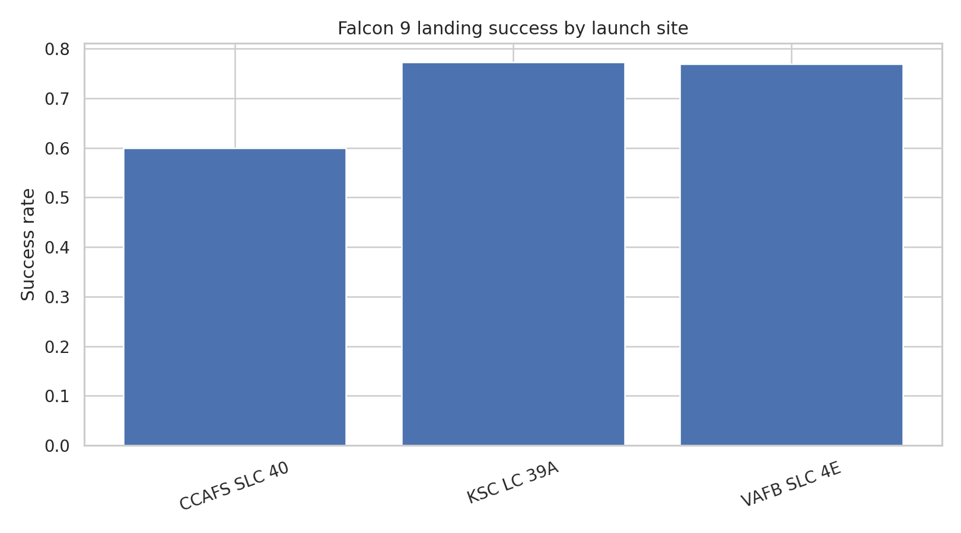
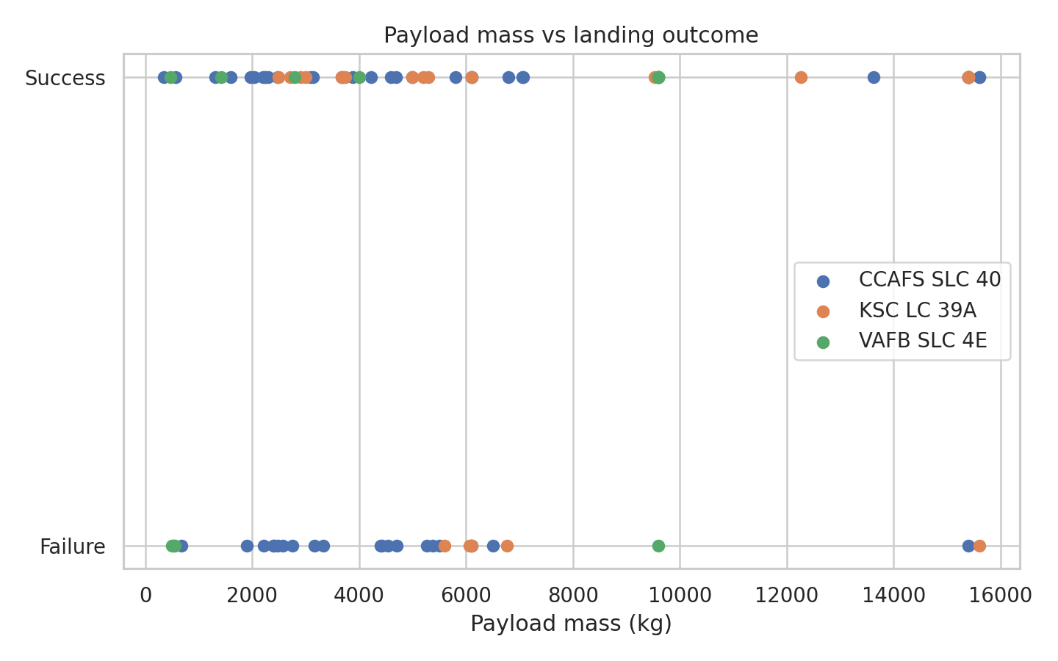
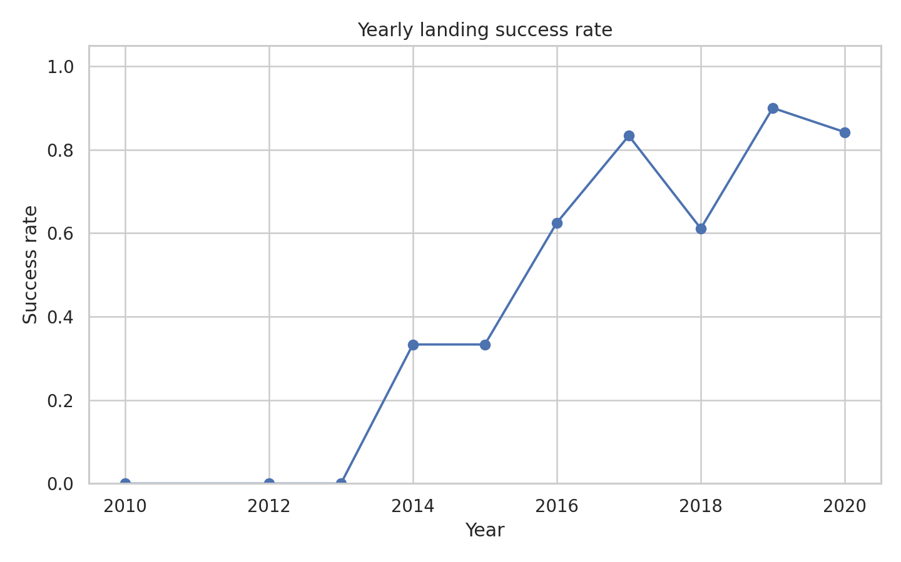
EDA Results — Visualization
Success rate, payload and time trends
Launch-site performance differs materially across the three U.S. sites in the dataset.
Payload mass is informative but not sufficient by itself to separate success from failure.
The strongest pattern is temporal: landing success rises sharply as reuse technology matures.
Independent reference implementation • IBM Applied Data Science Capstone workflow

Slide 9
EDA with SQL — Methodology
SQLite analytical queries
Loaded the cleaned dataset into an in-memory SQLite database.
Queries covered: launch counts by site; average payload by site; success rates by site; yearly launch and success trends; maximum payload rankings.
SQL provides a compact, auditable way to reproduce stakeholder questions without relying solely on Pandas transformations.
Example: SELECT LaunchSite, ROUND(100.0*AVG(Class),1) AS success_rate_pct FROM spacex GROUP BY LaunchSite;
Independent reference implementation • IBM Applied Data Science Capstone workflow

Slide 10
EDA with SQL — Results
Stakeholder-oriented findings
Launch volume: CCAFS SLC 40: 55, KSC LC 39A: 22, VAFB SLC 4E: 13.
Success rates: KSC LC 39A: 77.3%, VAFB SLC 4E: 76.9%, CCAFS SLC 40: 60.0%.
Yearly analysis confirms the transition from mostly unsuccessful early recoveries to consistently high success rates in 2019–2020.
SQL result files are included in the data/ directory for reproducibility.
Independent reference implementation • IBM Applied Data Science Capstone workflow

Slide 11
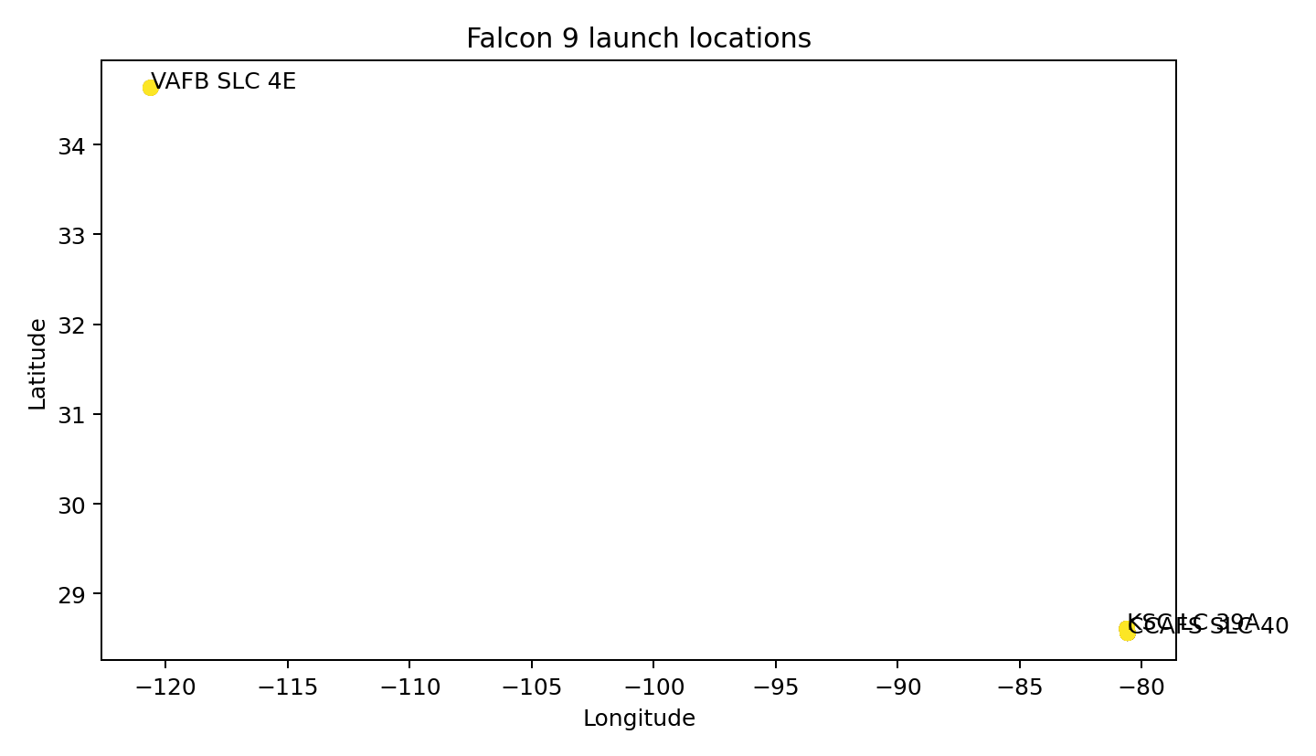
Interactive Visual Analytics — Folium
Launch-site geography and proximity analysis
Three launch complexes appear in the dataset: CCAFS SLC 40, KSC LC 39A and VAFB SLC 4E.
Folium map includes launch markers, popups and a marker cluster for interactive exploration.
The actual interactive map is saved as plots/spacex_launch_sites_map.html.
Independent reference implementation • IBM Applied Data Science Capstone workflow

Slide 12
Interactive Visual Analytics — Plotly Dash
Dashboard design and stakeholder use
Dashboard control: filter by launch site.
Primary KPI views: total launches and successful landings.
Visuals: success distribution and launch outcome by flight number / payload context.
Executable app.py is included and uses Dash + Plotly.
Independent reference implementation • IBM Applied Data Science Capstone workflow

Slide 13
Predictive Analysis — Classification Methodology
Model development and evaluation
Feature set: payload mass, flight count, grid fins, booster reuse, landing legs, block, reuse count, orbit and launch site.
Categorical features were one-hot encoded; standardized pipelines were used for Logistic Regression, KNN and SVM.
Compared four classifiers: Logistic Regression, KNN, SVM and Decision Tree.
Used an 80/20 stratified train/test split with random_state=42 for reproducibility.
Evaluation: test accuracy, classification report and confusion matrix; permutation importance used for interpretation.
Independent reference implementation • IBM Applied Data Science Capstone workflow

Slide 14
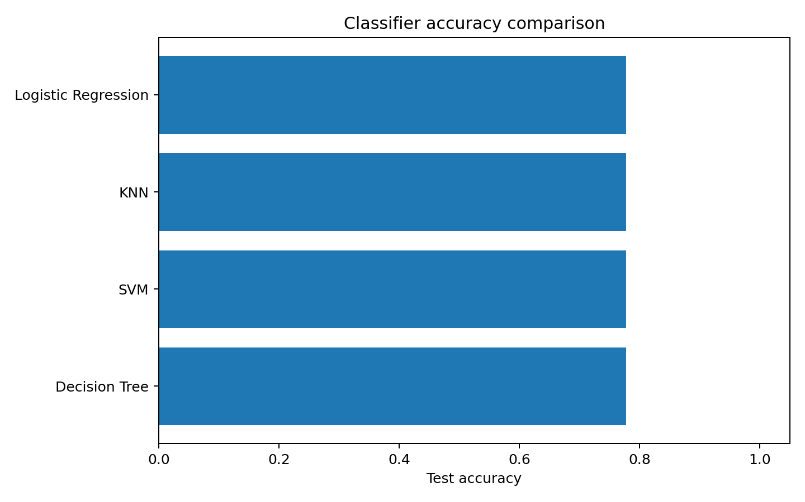
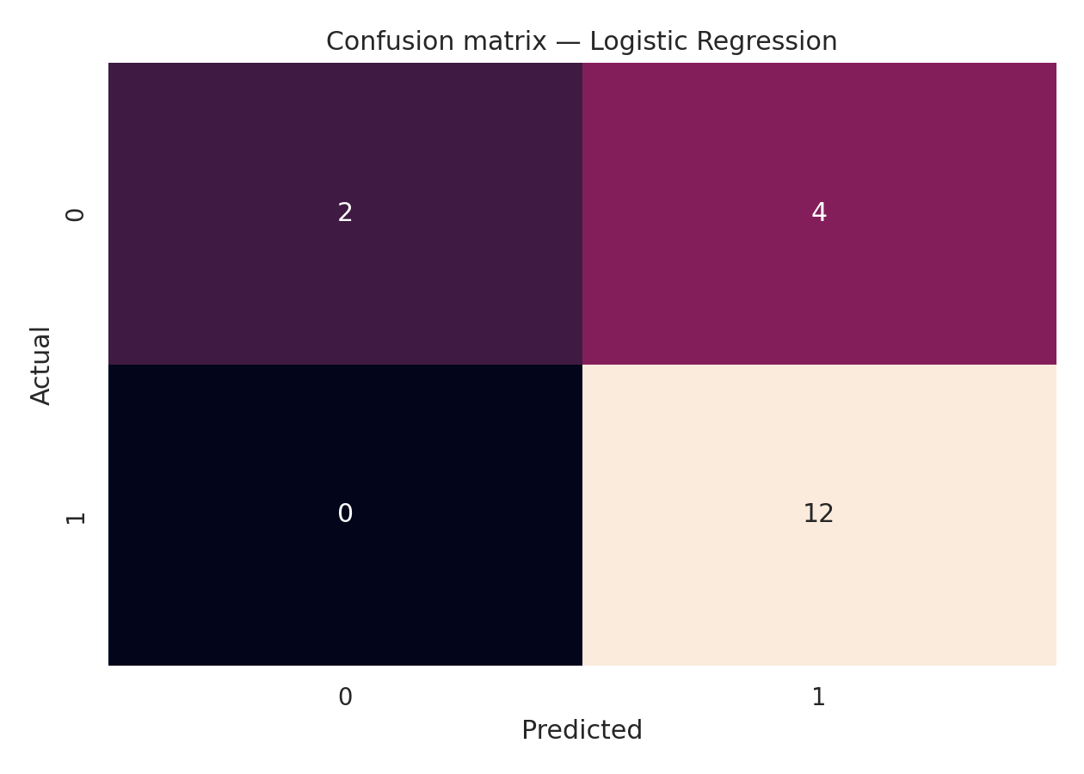
Predictive Analysis — Results
Model comparison and confusion matrix
All four models reached 0.778 test accuracy on the fixed holdout.
The confusion matrix shows 12 successful landings correctly identified and 4 false positives; no successful landing was missed in this split.
With a small sample, the result should be treated as directional rather than as a production forecast.
Independent reference implementation • IBM Applied Data Science Capstone workflow

Slide 15
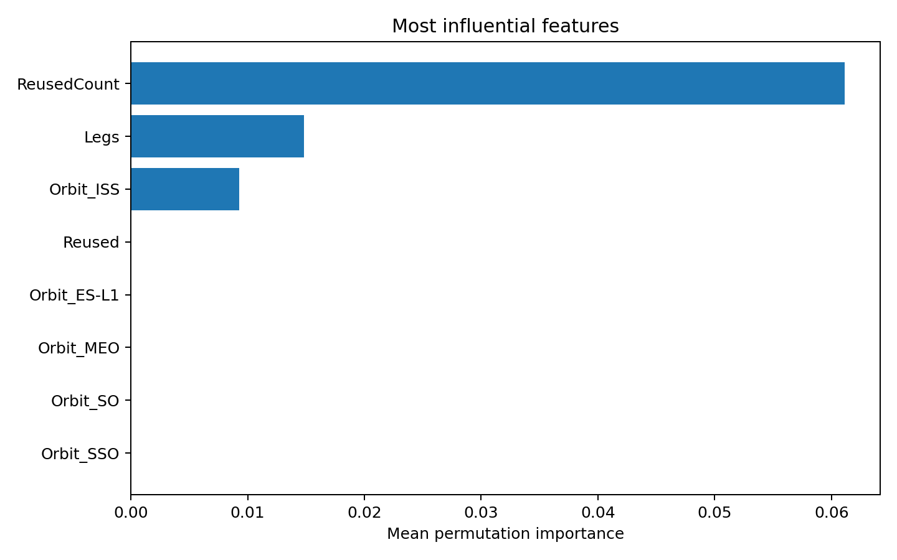
Predictive Analysis — Best Model Explanation
What the model learns from the data
Permutation analysis highlights ReusedCount and landing-related configuration variables as useful signals.
This is consistent with the engineering story: repeated booster use is associated with increasing operational maturity.
The model should be refreshed with newer launches and evaluated with time-aware validation before real bidding decisions.
Independent reference implementation • IBM Applied Data Science Capstone workflow

Slide 16
Conclusion
Business takeaway
The historical data contains strong evidence that Falcon 9 first-stage landing reliability improved over time.
Launch site, mission profile and booster history are useful predictors of landing outcome.
The classification models demonstrate a workable proof of concept, but the small dataset limits generalization.
For a competing provider, the analysis can support risk-adjusted launch pricing, site selection and scenario planning.
Next step: incorporate newer SpaceX API records, richer weather/mission variables and time-based validation.
Independent reference implementation • IBM Applied Data Science Capstone workflow

Slide 17
Creative & Innovative Insights
Beyond the basic rubric
“Reliability curve”: treat landing success as an operational maturity signal rather than only a binary label.
“Reuse premium”: repeated booster flights are associated with stronger observed outcomes, suggesting reuse history can act as a proxy for system maturity.
“Site context matters”: launch-site geography and mission profile can be combined with model predictions to build risk-adjusted bid scenarios.
“Model honesty”: when several classifiers tie on the holdout, the correct decision is to report the tie rather than overstate a marginal winner.
Independent reference implementation • IBM Applied Data Science Capstone workflow

Slide 18
Appendix — Deliverables & Repository
Files included in the reference package
8 executed Jupyter notebooks covering API, web scraping, wrangling, SQL, visualization, Folium, Dash and classification.
Data: dataset_part_1.csv, dataset_part_2.csv, dataset_part_3.csv, clean_spacex.csv and dashboard/map extracts.
Interactive: plots/spacex_launch_sites_map.html and app.py.
Presentation: this PDF plus the editable PPTX.
GitHub URL: PASTE YOUR OWN REPOSITORY URL HERE after uploading the project folder to GitHub.
Independent reference implementation • IBM Applied Data Science Capstone workflow

